Slide 1

Artificial Intelligence CCE 3 & 4
Topic: K Nearest Neighbours (KNN)
Sr.No | Roll No. | Name
1 | 177 | Harsh Sonone
2 | 181 | Yuvraj Suryawanshi
3 | 192 | Vedant Yadav

Slide 2
Problem Statement
Student Placement Eligibility: Classify students as Eligible / Not Eligible for placement using CGPA, attendance, backlogs and aptitude score.
Inputs
Independent Variables (Features):
Output
CGPA
Attendance %
Backlogs
Aptitude Score
Dependent Variable (Class Label):
Placement Eligibility
Eligible / Not Eligible
SUPERVISED LEARNING · CLASSIFICATION

Slide 3
What is KNN?
K-Nearest Neighbours (KNN) is a supervised learning algorithm that classifies a new data point by finding the K closest training points and taking a majority vote of their classes.
Supervised
Lazy Learner
Distance-Based
Learns from labelled examples such as past students and their results.
No training phase. It stores the data and works at prediction time.
Similar students lie close together in the feature space.
Euclidean Distance
d(p, q) = √( (p₁−q₁)² + (p₂−q₂)² + … + (pₙ−qₙ)² )
K = number of neighbours considered (here K = 3). An odd K avoids ties.

Slide 4
Working of the KNN Algorithm
Step 1: Collect labelled student data (CGPA, attendance, backlogs, aptitude, status).
Step 4: Sort the distances and pick the K nearest neighbours.
Step 2: Normalize the features and choose the value of K.
Step 5: Count the class labels (Eligible / Not Eligible) among the K neighbours.
Step 3: Calculate the distance from the new student to every student in the data.
Step 6: Assign the majority class as the predicted placement status.

Slide 5
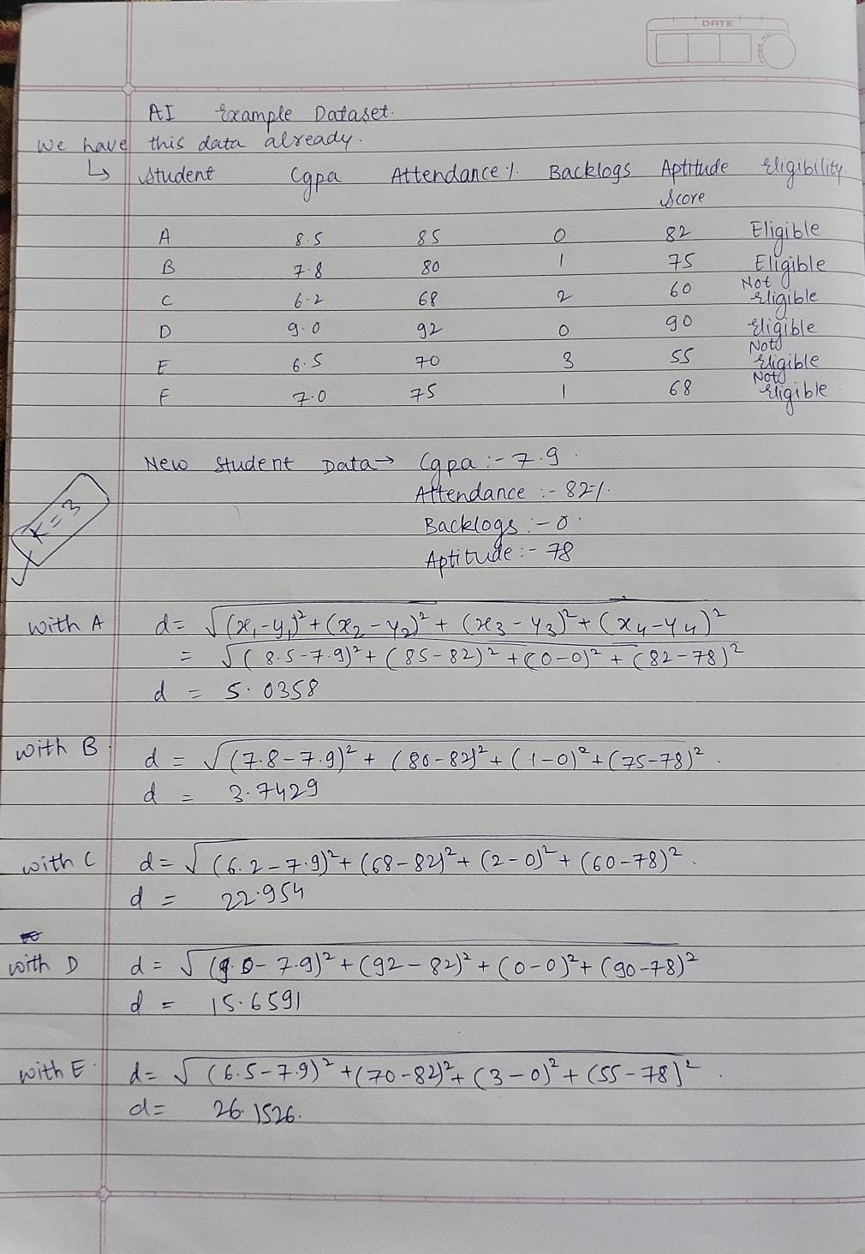
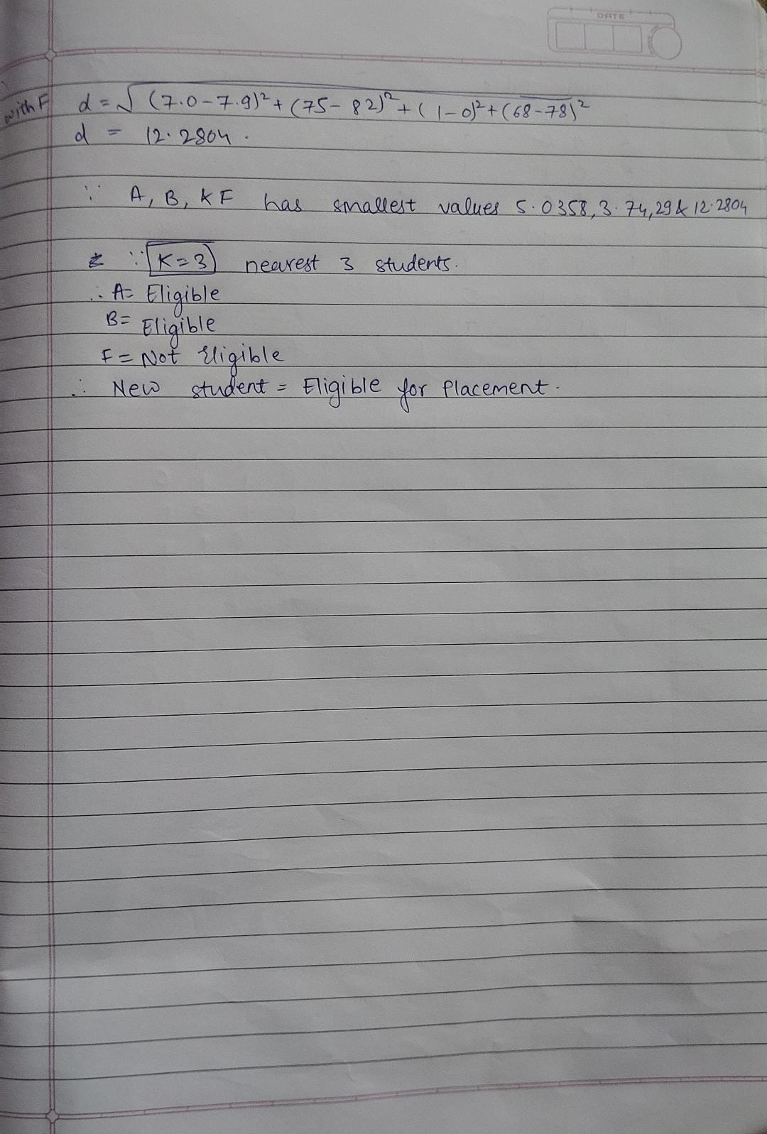
Explaining with Example

Slide 6
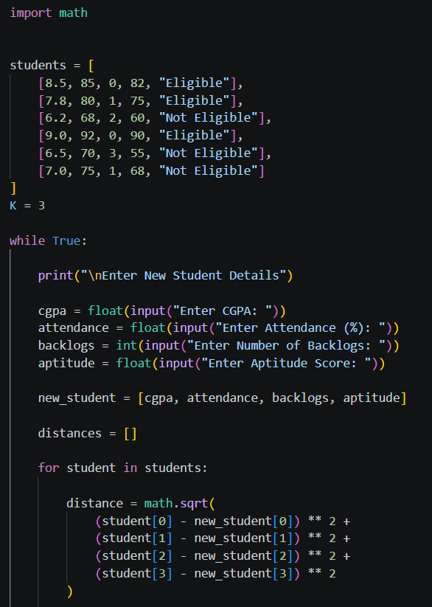
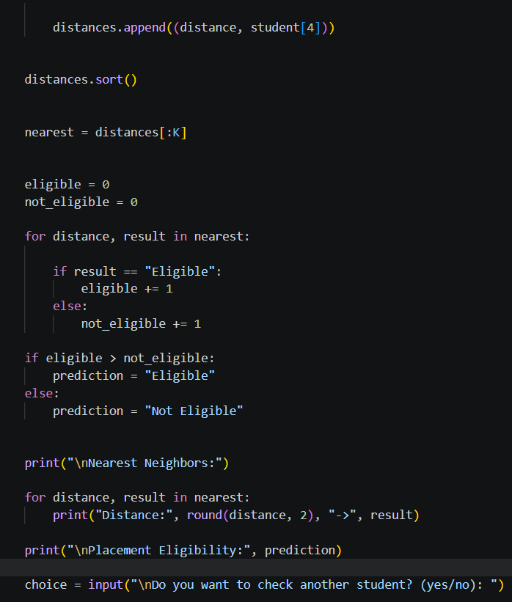
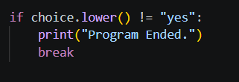
Python Code & Output
# Student Placement Eligibility using KNN
import math
from collections import Counter
# ([CGPA, Attendance, Backlogs, Aptitude], Label)
data = [
([8.5, 90, 0, 80], "Eligible"), ([7.8, 85, 0, 72], "Eligible"),
([6.2, 65, 3, 45], "Not Eligible"), ([9.0, 95, 0, 88], "Eligible"),
([5.8, 60, 4, 40], "Not Eligible"), ([7.2, 78, 1, 65], "Eligible"),
([6.5, 70, 2, 50], "Not Eligible"), ([8.0, 88, 0, 75], "Eligible"),
([5.5, 55, 5, 35], "Not Eligible"), ([6.8, 72, 2, 55], "Not Eligible"),
]
cols = list(zip(*[x for x, y in data]))
lo, hi = [min(c) for c in cols], [max(c) for c in cols]
def scale(x): # Min-Max normalization
return [(v - l) / (h - l) for v, l, h in zip(x, lo, hi)]
def distance(a, b): # Euclidean distance
return math.sqrt(sum((p - q) ** 2 for p, q in zip(a, b)))
def knn(new, k=3):
new = scale(new)
dist = sorted((distance(scale(x), new), y) for x, y in data) votes = Counter(y for _, y in dist[:k])
return dist[:k], votes.most_common(1)[0][0]
cgpa = float(input("Enter CGPA: "))
att = float(input("Enter attendance %: "))
back = int(input("Enter number of backlogs: "))
apt = float(input("Enter aptitude score: "))
k = 3
nearest, result = knn([cgpa, att, back, apt], k)
print("K =", k)
for d, label in nearest:
print("Distance:", round(d, 3), "->", label)
print("Placement Status:", result)

Slide 7
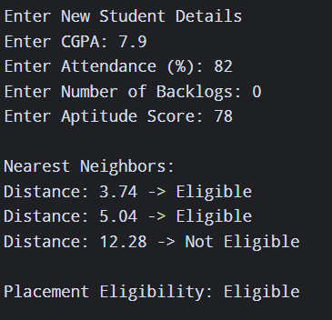
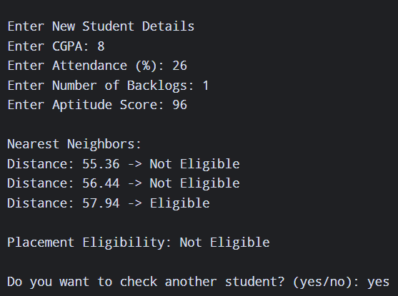
OUTPUT

Slide 8
Applications of KNN
Education & Placement
Predicts student placement eligibility, performance and dropout risk from academic records.
Healthcare
Classifies patients as healthy or at-risk (e.g. diabetes, heart disease) from medical measurements.
Recommendation Systems
Suggests movies, products or music by finding users with similar tastes.
Finance & Banking
Credit scoring, loan approval and fraud detection by comparing with similar past cases.
Image & Pattern Recognition
Handwritten digit recognition, face recognition and document classification.

Slide 9
Conclusion
KNN classifies a new student by the majority class of its K nearest neighbours.
It is simple and intuitive, with no training phase.
Feature scaling and the choice of K strongly affect accuracy.
It slows down on large datasets because it measures distance to every record.
In our example, the student with CGPA 7.0 was predicted Not Eligible for placement.
Thank You

